Slide 1
Statistical Prediction and
Uncertainty Management
Hiroe TSUBAKI
The Institute of Statistical Mathematics,
JAPAN
Prof. Emeritus, Univ. Tsukuba

Slide 2
Contents
Data Centric Sciences: Mission of ISM
The Grammar of Science
Uncertainty Management and Scientific Decision Process
  Decision Tree Analysis and Value of Additional Information

Slide 3
RoiS / ISM Data-centric research commons project
International activities organized by the Institute of Statistical Mathematics (ISM) in the Data-Centric Science Research Commons project of the Research Organization of Information and Systems (ROIS)
Notes:
First I would like to briefly explain our organizational structure and outline of the data-centric research commons project by ROIS.
The details are shown in the materials we distributed to you.

Slide 4
Four National Inter-University Research Institutes under ROIS
ROIS
The Research Organization of Information and Systems since 2004
ISM
The Institute of Statistical Mathematics since 1944
NII
The National Institute of Informatics since 2000
NIG
the National Institute of Genetics since 1949
NIPR
the National Institute of Polar Research since 1973
Notes:
The Research Organization of Information and Systems (ROIS), which was established in 2004, integrates four of Japan’s national institutes, the Institute of Statistical Mathematics (ISM), the National Institute of Genetics, the National Institute of Polar Research, and the National Institute of Informatics, into the Inter-University Research Institute Corporation (IURIC) in order to produce a new cooperative research style that goes beyond traditional academic fields.
ISM, The Institute of Statistical Mathematics ,itself was established in 1944, because there are no department of statistics in universities in Japan. ISM is a unique research organization on advanced theory and application for statistical methods..

Slide 5
Frame of
Data-Centric Research
Commons Projects
By ROIS
Notes:
The coordination of these institutions, facilitated by ROIS, will contribute to opening new areas of research and performing integrated transdisciplinary research.
This framework will allow a data-centric approach to the complex issues of life, earth, environmental and social sciences.
We will also widely share with the community, the outcomes, resources and research platforms necessary for new frontiers of research.
Informatics methodologies in addition to operation of databases and networks will also enable us to serve as an information platform that will support rapid and effective development of research both in and out of Japan.

Slide 6

Mission of the ISM
The ISM conducts studies relating to theory and applications of statistics and data science
Bringing together many and various researchers engaged in “data-centric science.”
  As part of efforts to develop a new data-centric science research environment
  for both domestic and international universities and research institutions,
  the ISM has supported ROIS Data-centric Research Commons projects
  in the fields of human social science and earth environmental science systems.
Notes:
The ISM conducts studies relating to theory and applications of statistics and data science
Bringing together many and various researchers engaged in “data-centric science.”
As part of efforts to develop a new data-centric science research environment for both domestic and international universities and research institutions, the ISM has supported ROIS trans-disciplinary research projects in the fields of human social science and earth environmental science systems.

Slide 7
the Grammar of Science as an Interface Between Statistics and Societies
Methods for Prediction

Slide 8
Two Typical Misinterpretations to Science & Statistics
Real business is beyond the scope of Science
    Why Business Sciences?
      Business is material for science!
Statistics is a kind of applied mathematics
    Why Statistical Methodology?
      Statistics is the grammar of science

Slide 9
Definition of Scientific Activities
The attempt to make the chaotic diversity of our sense experience correspond to a logically uniform system of thought
  A. Einstein, 1940
Akademie Olympia
http://de.wikipedia.org/wiki/Akademie_Olympia

Slide 10
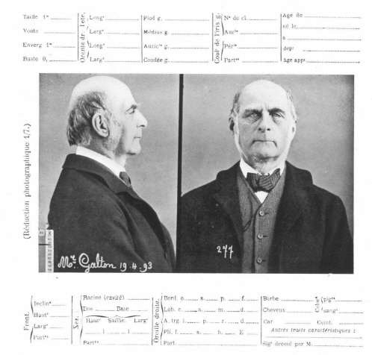
Statistical Science
To discover methods of condensing information concerning large groups of allied facts into brief and compendious expressions
suitable for discussion
  Francis Galton (1883)
    Inquiries into Human Faculty and its Development
http://www.mugu.com/galton/

Slide 11
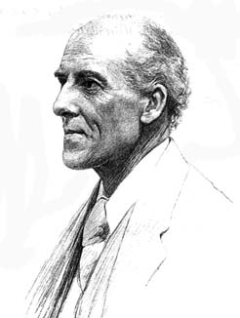
Every field is also material for science
Karl Pearson, 1892
    The unity of all science consists in its method, not in its material.
    The field of science is unlimited; its material is endless, every group of natural phenomena, every phase of social life, every stage of past or present development is material for science.
www-groups.dcs.st-and.ac.uk/ ~history/Mathematicians/Pearson.html

Slide 12
The Grammar of Science
Process：
  Planning a hypothetical law by analyzing cause and effect of observed phenomena
  Fitting the model or the hypothetical law to the related facts to get the empirical law
  Checking performance of the obtained law to clarify the needs of classification of the facts
    The obtained law may be useful for predicting events in future
The man who classifies fact of any kind whatever, who sees their mutual relations and describes their consequences, is applying the scientific method and is a man of science

Slide 13
Karl Pearson (1892) The Grammar of Science
A man gives a law to Nature (for prediction or interpretation)
  Statistical Science as a new way to Scientific thinking in the 20th century.
    Systematic ways to derive “a scientific law”
    Not Scientific Objects but Scientific Process
      Plan: Statistical Methods for Planning
        Careful and accurate classification of facts
        Observation of their correlation and sequence
      Do: Constructing Scientific Laws
        Discovery of scientific laws by aid of creative imagination
      Check: Checking the Laws
        Self-criticism and the final touchstone of equal validity for all normally constituted mind
    Systematic Development of Statistical Methodology as the Supporting tools for the Scientists along the Grammar
      Probabilistic interpretation of cause and effect
      Statistical description of a scientific law for prediction
Notes:
13

Slide 14
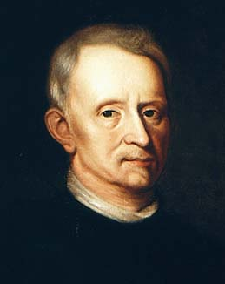
Scientific Law for Prediction in Societies?
Could you give a scientific law like “Hooke’s law”
in Business or Societies?
http://www-groups.dcs.st-and.ac.uk/~history/Mathematicians/Hooke.html

Slide 15
Hooke’s Laws in the Financial data？
# of the Japanese listed enterprises in 1996 = 2091
Output Variable
  Business Income
Input Variables
  Total Asset, Working Force, Net Debt
Others：
  Company Name, Industrial Code

Slide 16
Could you find any systematic association between Working Force data & Business Income data?

Slide 17
Constructing Business Sciences
Step 1: Planning a law
Analyzing cause and effect of observed phenomena
  Model Building
  Descriptive Methods
    Describing the Dispersion and Association
      Dispersion: Histogram and Standard Deviation
      Association: Scatter Diagram and Correlation

Slide 18
Description of Dispersion
Mean:10.9 sd:1.40
Geometric Mean: \52560million
Mean：\195400million
Standard Deviation：\857400million

Slide 19
Ideal Laws：
Constant Returns to Scale：
Hooke’s Law
  Stress=const × Strain
Approximately Linear Relationship
  Y~a+bx
  Y ~a+b₁x₁+b₂x₂+･･･+b_{p}x_{p}
  Intercept, a=0→Hooke’s Law
Power Law：Y~ax^{b}
    Power, b=1→Proportional
    logY~log a+b log x
  Y~ax^{b1}x^{b2}・・・x^{bp}
    logY~log a+ b₁ log x₁ +b₂ logx₂+・・・+b_{p} logx_{p}
      Log Linearity
    Sum of the power coefficients,
    b₁+b₂+・・・+b_{p}=1
    →Constant Returns to Scale

Slide 20
Description of Association
Linear relationship?
Log Linear relationship!
Ｒ^{２}＝０．１８
Ｒ^{２}＝０．７２

Slide 21
Step 2: Model Fitting for Prediction
Fitting the model or the hypothetical law to the related facts (data) to get the empirical law
  Regression Analysis
    Log (Business Income)
    =4.24+0.97 log (Working Force)+residuals
    standard deviation of residual=0.74
      Residual = Observed Value – its Predict by the Model
        Prediction error
      Residual Standard Deviation of log Business Income = 1.40

Slide 22
Fitting Model
Original Variation
Variation of Residuals

Slide 23
Step 3: Checking the Fitted Model
Checking performance of the obtained law to clarify the needs of classification of the facts
  Diagnostics
    Total Performance Measures of the prediction model
      R², Residual SD
    Exploring Needs for Further Classification
      Residual Analysis

Slide 24
Evolution of Prediction Model
Log(BI)=1.15
+0.28 log(WF)
+0.46log(TotalAssets)
+0.27log(Net Debt)
+residuals
  R²=0.89
  residual SD=0.47
    Residuals SD of the simple model =0.74
    Total performance of the prediction model is significantly improved.
Residuals of the simple model
Residuals of the new model

Slide 25
Residual Analysis: Role of Prediction Errors
Companies such that the residuals>1.5
1500 ITOCHU 1.854051
1501 Marubeni 1.853562
1502 TOMEN 1.835570
1503 Nichimen 1.670540
1518 KANEMATSU 1.761537
1528 CHUO GYORUI 2.258017
1529 MITSUI & CO. 1.660330
1536 TOHTO SUISAN 2.064938
1537 TSUKIJI UOICHIBA 1.967221
1539 OSAKA UOICHIBA 1.878274
1542 DAITO GYORUI 2.032328
1548 SUMITOMO 1.960161
1557 Nissho Iwai 1.662237
1564 TOKYO SANGYO 2.552716
1625 CHUBU SUISAN 1.769532
2090 SHINKO GYORUI 2.031702

Slide 26
Companies such that the residuals< -1.3
9 Chugai Mining -1.521919
480 KYOWA HAKKO KOGYO -1.392347
548 Green Cross -1.819432
568 INTERNATIONAL REAGENTS -1.557378
955 ISEKI & CO. -1.372723
1142 SANYO ELECTRIC -1.338558
1762 HOKKAIDO SHINKO -1.536938
1781 TOBU RAILWAY -1.322300
1786 Keihin Electric Express Railway -1.354466
1787 Odakyu Electric Railway -1.333317
1789 Keisei Electric Railway -1.389206
1798 Kinki Nippon Railway -1.387198
1800 HANSHIN ELECTRIC RAILWAY -1.381091
1801 Nankai Electric Railway -1.490005
1803 Kobe Electric Railway -1.667814
1804 Nagoya Railroad -1.348491
1807 Sanyo Electric Railway -1.558611
1876 Nihonbashi Warehouse -1.327809
1945 WESCO -1.861918
1954 Koshien Tochi Kigyo -1.340120
1980 KYOTO HOTEL -1.328580

Slide 27
Needs for Classification
After Classification
  Prediction Model for Commerce (#181):
    ~0.27+0.08logWF+0.77logTA+0.21logND
      Residual SD: 0.51 R²:0.89
  Transportation(#51)：
  ~1.86+0.64logWF+0.59logTA-0.24logND
      Residual SD: 0.35 R²:0.93
  Others：
    ~1.26+0.38logWF+0.40logTA+0.24logND
      Residual SD: 0.38 R²:0.92

Slide 28
Concluding Remarks: This is a way to creating a science
Summary
  Scientific process to derive an empirical law from facts through PDCA cycle
Role of the “Action” stage? ⇒ Improvement
  Redesign of the facts through optimization
    Man gives a law to natures：→ Man should improve the law for himself

Slide 29
PPDAC as a Statistical Enquiry Cycle for Elementary Education in New Zealand
http://new.censusatschool.org.nz/wp-content/uploads/2012/11/data-detective-mature.en_.pdf

Slide 30
Approach to Effective Problem Solution supported by PPDAC
H. Tsubaki (2014) ICQ Tokyo.
Exploratory Gap Analysis: Residual Analysis
Brain Storming to Recognize Unexpected Ideas
Check
Gap between
requirements and realities;
What, Who, When, Where, How
Action ＝
solution
Plan
Implementation of the Optimization
Do
Plan
What to measure
Data
Information from “Genba”
Analysis
Causal Analysis
Conclusion
Plan for Solution
Finding
Problem
Process Control
Design of Survey,
Experiment
& Interview
What, Who, When, Where, How
Daily Management Cycle
=PDCA cycle
QC Story for Kaizen (Problem Solving)
=
PPDAC cycle
Confirmatory Analysis
& Optimization
Quantitative & Qualitative Modelling

Slide 31
Uncertainty Management and Scientific Decision Process
  A Method of Decision Making for Future
  Decision Tree Analysis and Value of Additional Information
  Bernard W. Taylor (2009), Introduction to Management Science, 10th ed., Global Edition, Pearson Education

Slide 32
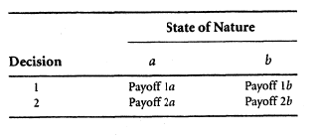
Common Formulation of Decision Making
Bernard W. Taylor (2009), Introduction to Management Science,
10th ed., Global Edition, Pearson Education (US)
The Components of Decision Making
  The Decision or Action: D
  A State of Nature: Y
    An Actual Event that may occur in the future
    Variety of events usually appears and the variation may be formulated with the probability theory.
      The Decision Maker has no clear idea which states of nature will occur in the future and has no control over them
  Profit(Loss) Function or
  Payoff Tables:
  Profit(D, Y), Loss(D,Y)
    Illustrating the payoffs from the different decisions, given the various states of nature
Payoff Table
It is often possible to assign probabilities to the states of nature to aid the decision maker in selecting the decision that would have possibly the best outcome under uncertain situation.

Slide 33
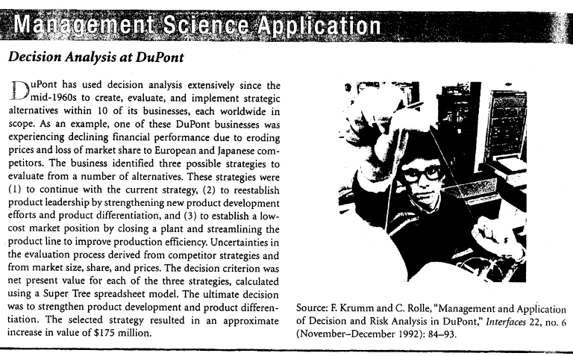

Slide 34
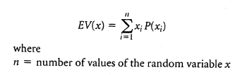
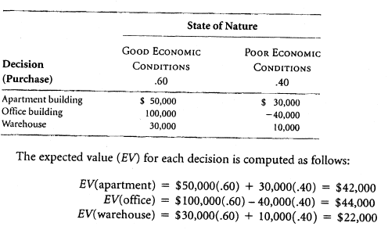
Too Simple Decision Making with Probabilities
Maximizing Expected Value
Let us suppose that
  based on several economic forecasts, the investor is able to estimate a .60 probability that good economic conditions will prevail
  and a .40 probability that poor economic conditions will prevail
Payoff table with probabilities for states of nature

Slide 35
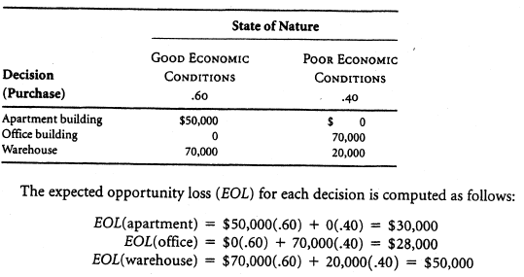
Minimizing
Expected Opportunity Loss
Minimizing the expected value of the regret of each decision
EOL(office) is also considered as the Expected Value of Perfect Information (EVPI) that assured us which state of nature is going to occur.

Slide 36
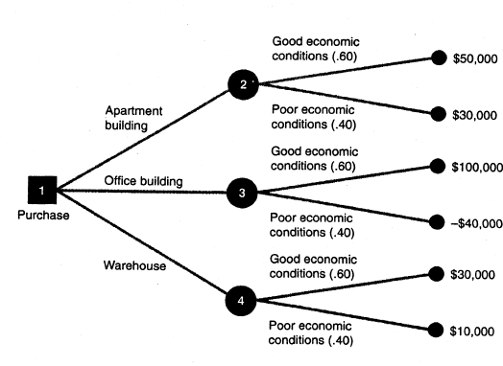
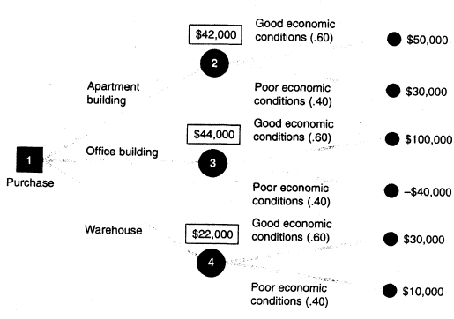
Decision Trees
A graphical diagram consisting of nodes and branches.
  Square Decision Nodes
  Circle Probability Nodes
  Branches representing Decision Alternatives
  The decision tree represents the sequence of events in a decision situation.
    In a decision tree the user computes the expected value of each outcome and makes a decision based on these expected values.
    The primary benefit of a decision tree is that it provides an illustration of the decision-making process.
    This makes it easier to correctly compute the necessary expected values and to understand the process of making the decision.

Slide 37
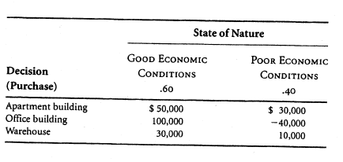


Decision Analysis with Additional Information
-Applying Bayesian Analysis-
the investor has determined conditional probabilities of the different report outcomes, given the occurrence of each state of nature in the future.
We will use the following notations to express these conditional probabilities:
  g:good economic conditions
  p:Poor economic conditions
  P:positive economic report
  N:negative economic report
A statistician will provide the investor with a report predicting one of two outcomes.
The report will be either
positive, indicating that good economic conditions are most likely to prevail in the future,
or
negative, indicating that poor economic conditions
will probably occur
Prior Probability

Slide 38
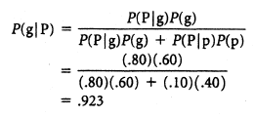
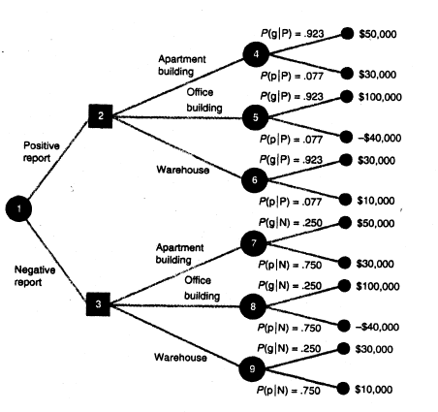

Decision Tree with Posterior Probability by means of Bayes formula

Slide 39
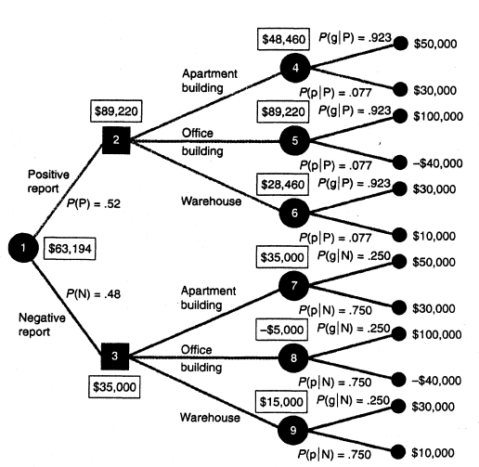
According to the formula of total probability

Slide 40



Value of Additional Information:
The Expected Value of Sample Information (EVSI)
The investor should not pay to the statistician by more than $19,194!
The Efficiency of Sample Information
The economic report by the statistician is viewed by the investor to be 69% as efficient as perfect information.
In general, a high efficiency rating indicates that the information is very good or close to being perfect information,
and a low rating indicates that the additional information is not very good

Slide 41
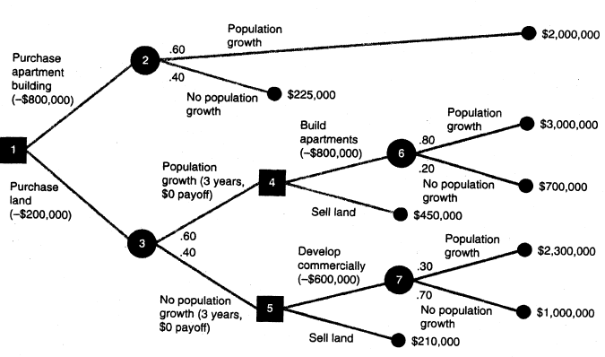
Though the real risk scenario may be more complex than that described by the theory, however the rational policy making should be attained only through the continual improvement of the prediction performance of a model for the probability and loss of events by using data-centric science..
Note: Usually these probabilities are estimated probability with uncertainty
Note: The predicted payoff should be represented not as a value but as probability distribution of the payoff

Slide 42
Concluding Remarks
Role of Statistical Prediction in Decision Making
  Predicting
  probability of the states of Nature
    and
  the pay-off given the states of Nature and possible decisions
  as accurate as possible
Optimal Decision in Real Society?
  Existing Stakeholders with Different Payoff Functions or Values and Imaginary Stakeholders in Future
    Distribution or Redistribution of Risk and Benefit into the Stakeholders
    Design of our Social Value Function
      Assignment to a weight to each Stakeholder’s value function
    Restriction from the total budget and resources
    Ethical Restriction to avoid some irreversible loss or damage to moral personality

